Slide 1
LDB
<number>

Slide 3
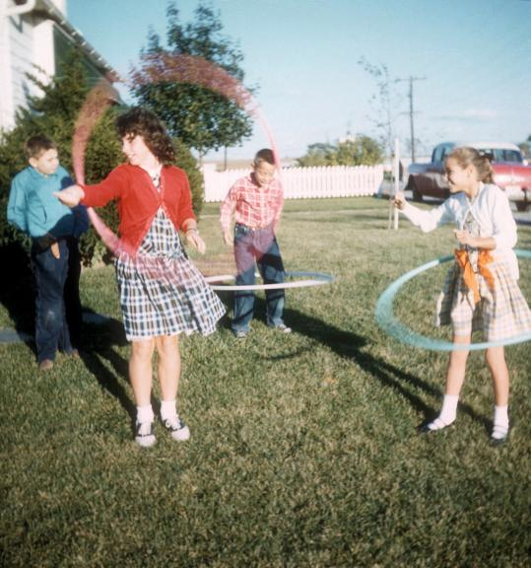
195_-LDB003 Linda Frankie w Tyler and Diane Ake
<number>

Slide 4
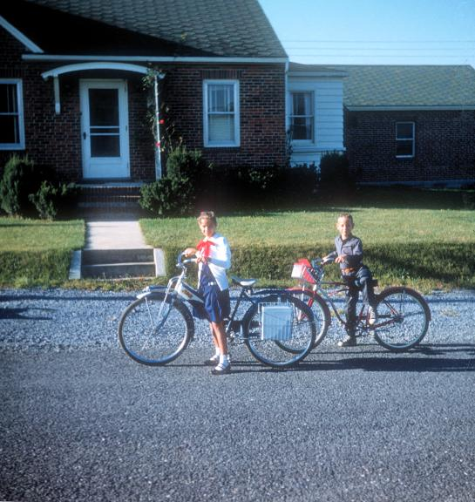
195_-LDB004 Linda Franklin Off to School
<number>

Slide 5
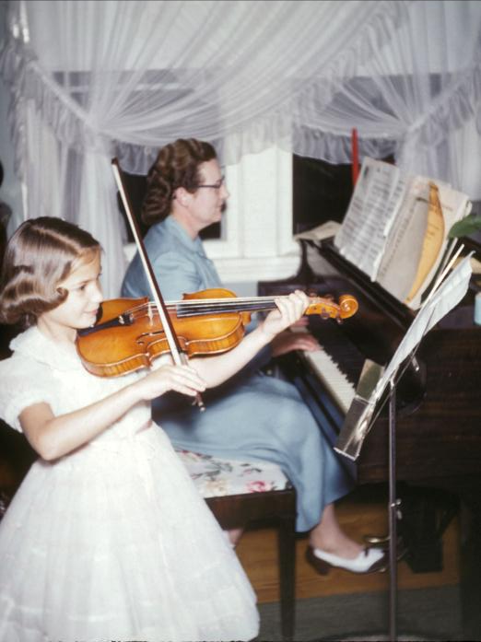
195_-LDB008 Hazel accompanying Linda on violin
<number>

Slide 6
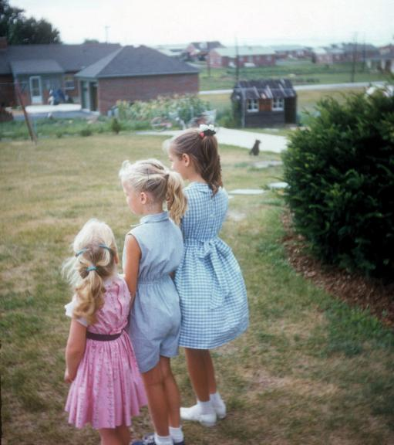
1956- LDB005 Linda Kathy Joanne - year to be confirmed
<number>

Slide 7
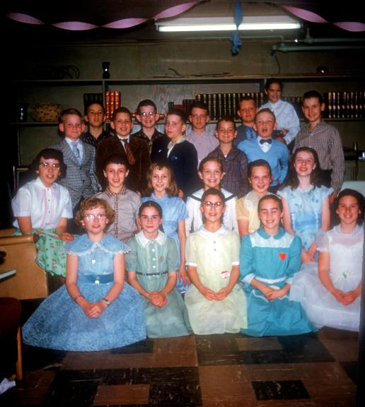
1958-LDB010 Linda's Birthday party - 1958 - aged 11 years with Frankie Larry and Jeannie Martin
<number>

Slide 8
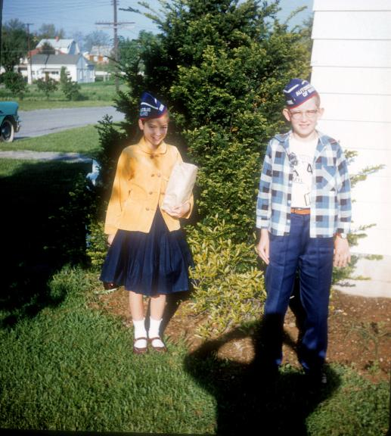
1958-LDB011 Safety Patrol Members - Linda and friend 1958
<number>

Slide 9
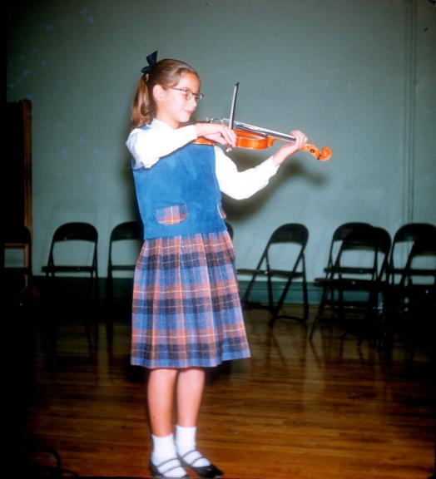
1958-LDB012 Linda - 1958 -Ruitan Talent Show (4th winner)
<number>

Slide 10
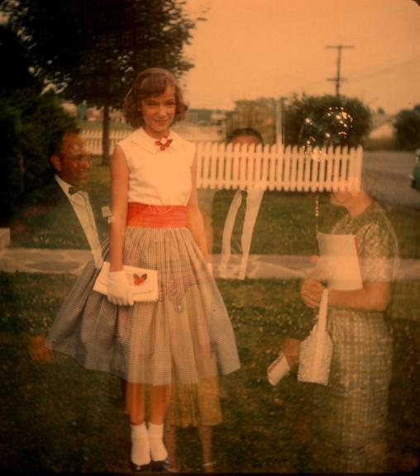
1959-LDB042 Linda all dressed up for a double exposure - slide date Aug 1959
<number>

Slide 11
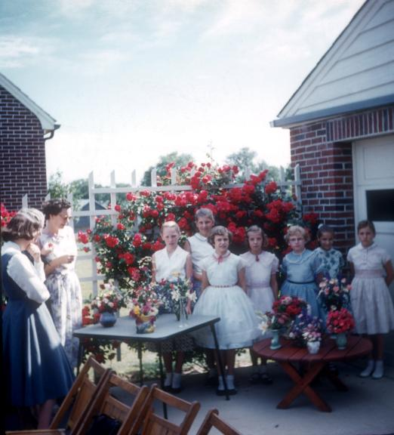
1958-LDB037 Linda and a bunch of other girls with Jewel Hicks - perhaps for a flower arranging class - 1958 slide date
<number>

Slide 12
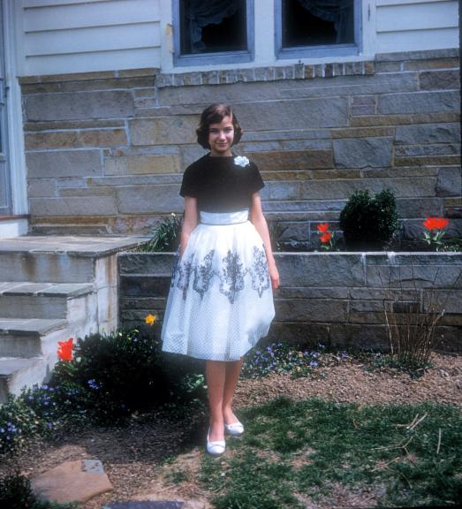
1960-LDB002 Linda Easter
<number>

Slide 13
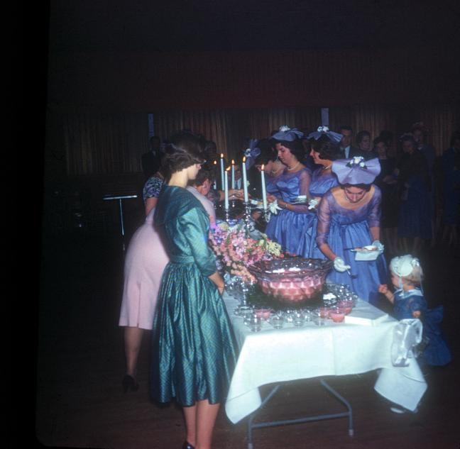
1961-LDB035 Anna Grace Baer weds Paul Holloway - 1961
<number>

Slide 14
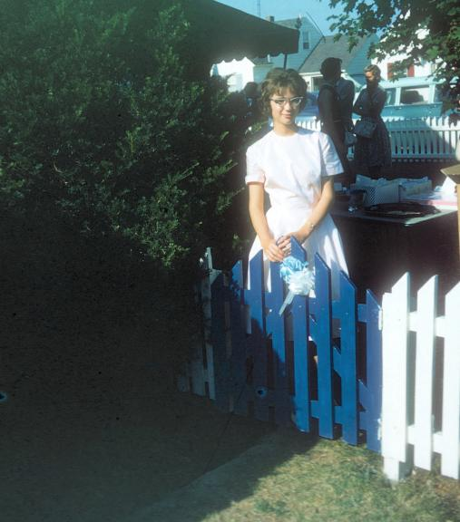
1962-LDB001 Linda and blue gate Jun1962
<number>

Slide 15
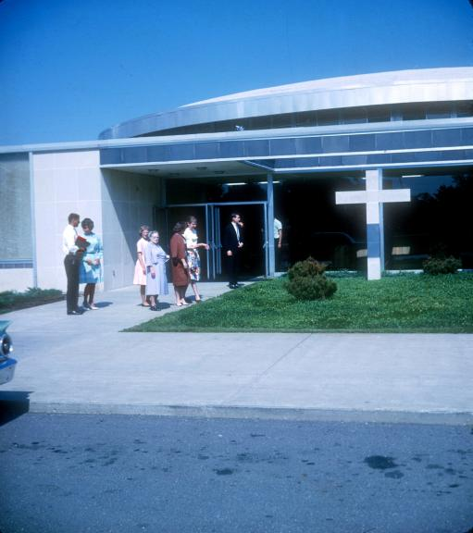
1963-LDB033 At Goshen College Chapel -GM Theoda, Kathy Bennett; Bill and Marilyn and others - 1963 slide date
<number>

Slide 16
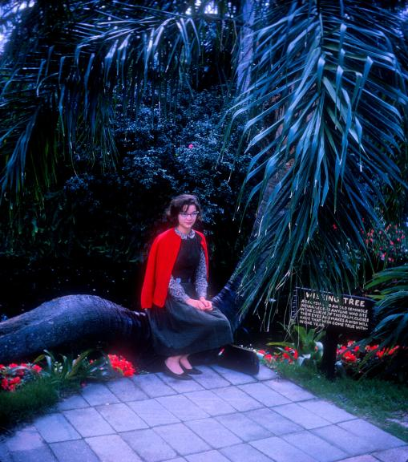
1964-LDB013 wishing may make it so, Linda. You know what happened to Bonnie! Feb. 1964
<number>

Slide 17
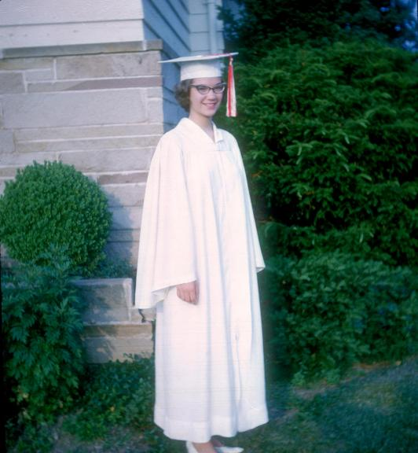
1965-LDB014 - Linda's High School graduation 1965
<number>

Slide 18
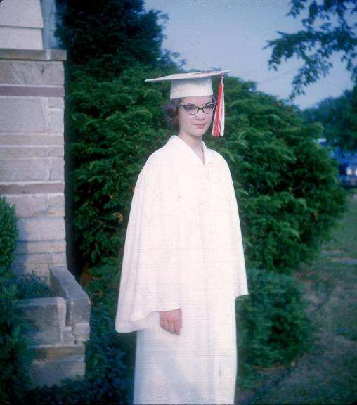
1965-LDB015 - Linda's High School graduation 1965
<number>

Slide 19
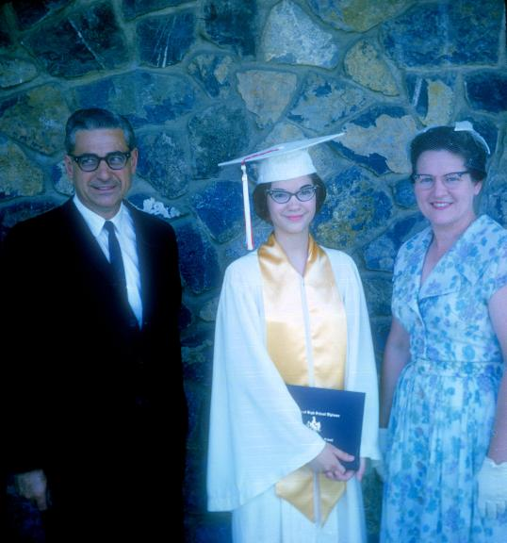
1965-LDB016 - Proud Parents (Amos and Hazel) with Linda for her High School graduation 1965
<number>

Slide 20
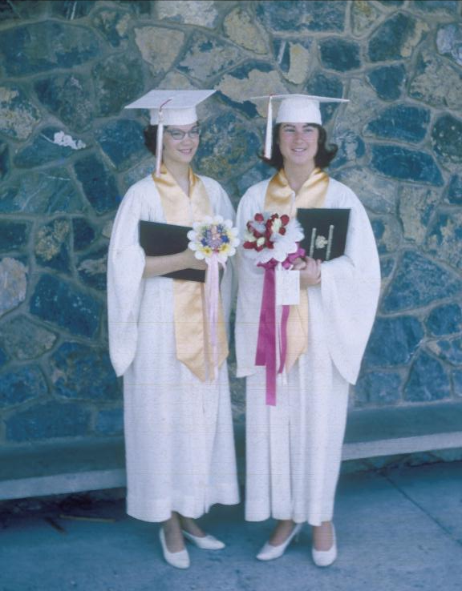
1965-LDB007 Linda with cousin Deborah Baer NHHS Grads 1965
<number>

Slide 21
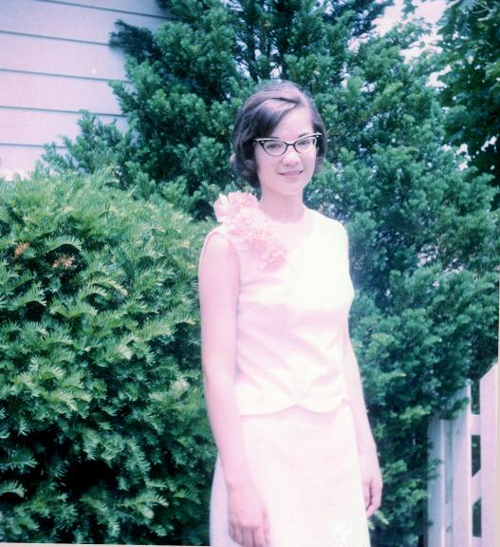
1965-LDB018 - Linda's graduation dress for her High School graduation 1965
<number>

Slide 22
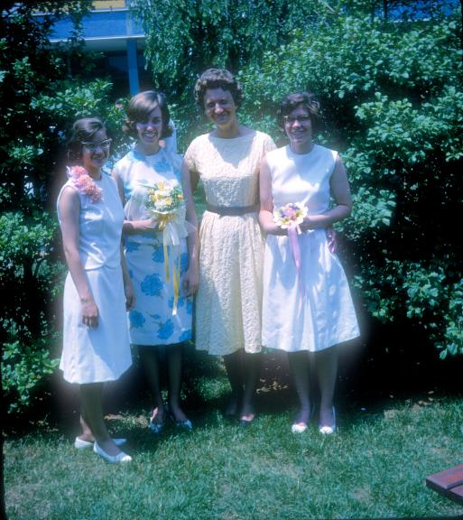
1965-LDB019 - Linda Baer, Karen Bond, Mrs Doris Warfield, Martha Askey at HS graduation 1965
<number>

Slide 23
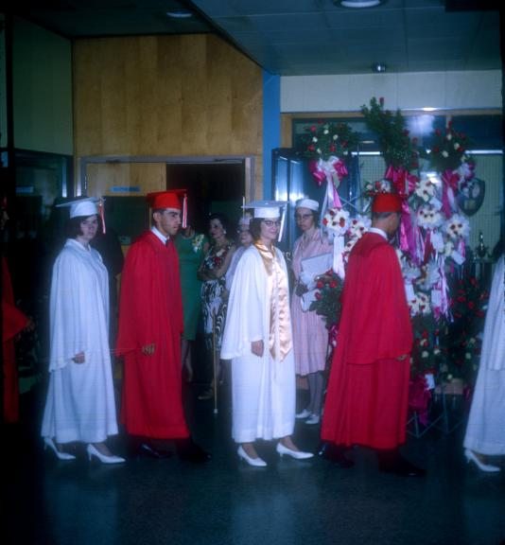
1965-LDB020 - Linda HS graduation- yellow band denotes National Honor Society - #7 in class of 525
<number>

Slide 24
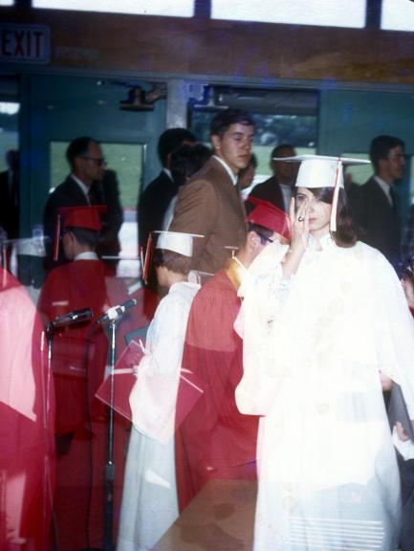
1965-LDB038 Someone is teary-eyed about graduating, but WHO no slide date
<number>

Slide 25
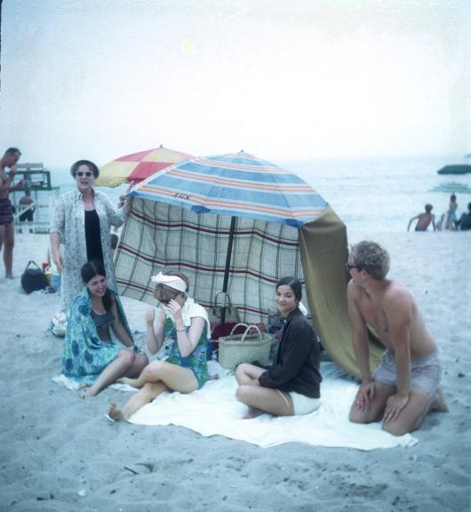
1966-LDB021 - Beach party with Linda, Evie, Hazel and two other people mid-1966 per slide date
<number>

Slide 26
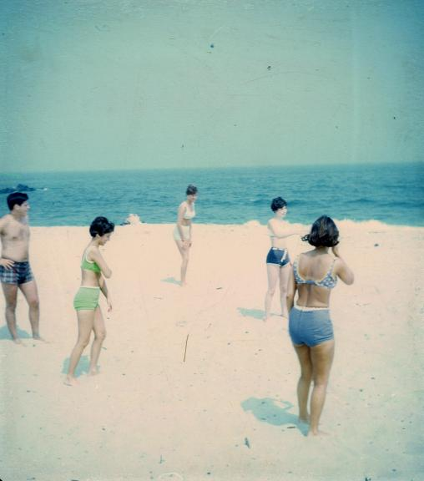
1966-LDB022 - Beach party with Bill, Linda, Evie, and other people mid-1966 per slide date
<number>

Slide 27
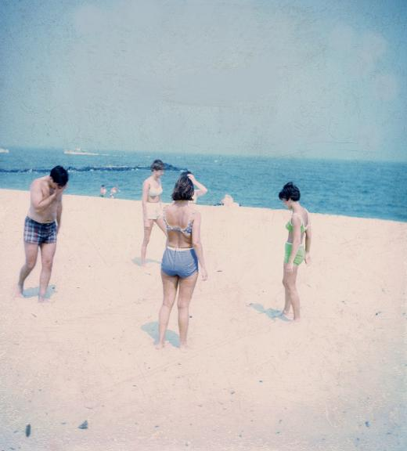
1966-LDB023 - Beach party with Bill, Linda and other people mid-1966 per slide date
<number>

Slide 28
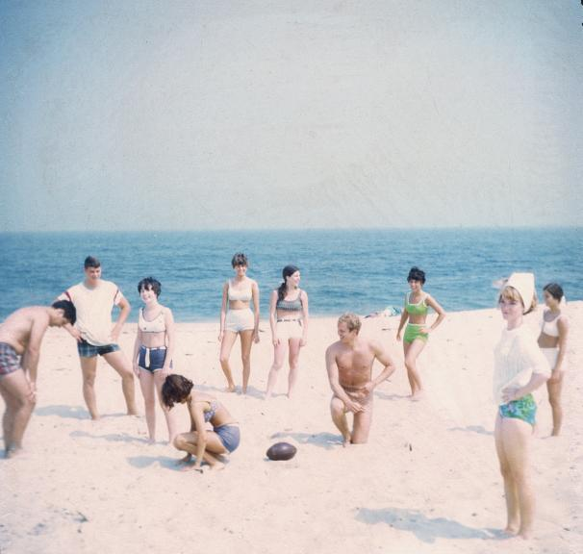
1966-LDB024 - Beach party with Bill, Evie, Linda and other people mid-1966 per slide date
<number>

Slide 29
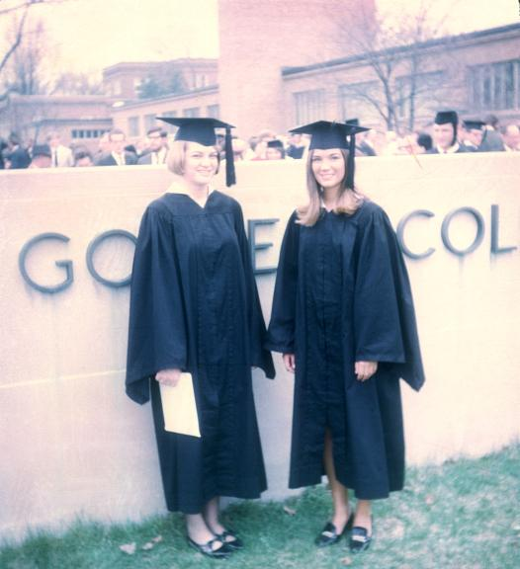
1969-LDB026 - Linda's graduation from Goshen College with friend - 1969
<number>

Slide 30
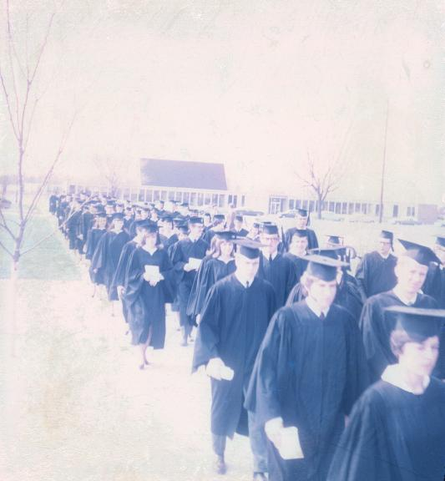
1969-LDB027 - Linda's graduation from Goshen College - 1969
<number>

Slide 31
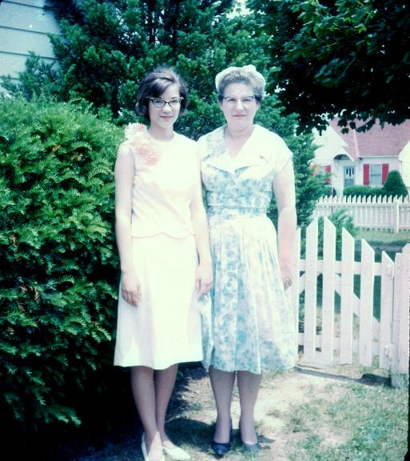
1965-LDB017 - Hazel with Linda for her High School graduation 1965
<number>

Slide 32
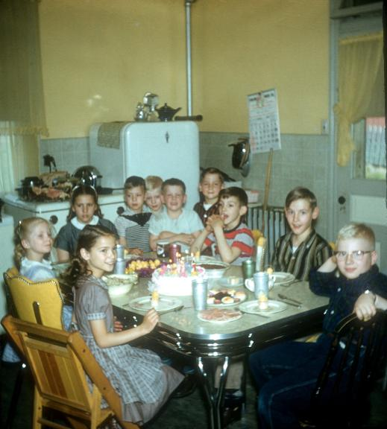
1957-LDB006 Lindas 10th BD Apr 1957 at Theresas with all the grandkids
<number>

Slide 33
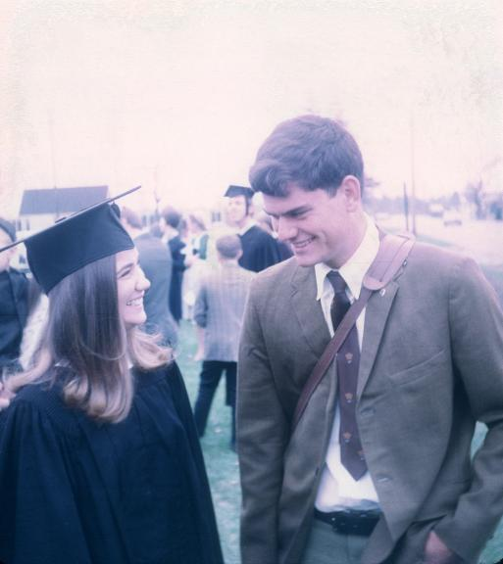
1969-LDB028 - Linda's graduation from Goshen College with a friend - 1969
<number>

Slide 34
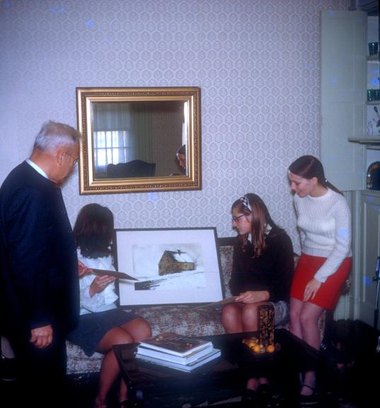
1969-LDB031 Linda and friends with the Hans Herr House painting- year to be confirmed
<number>

Slide 35
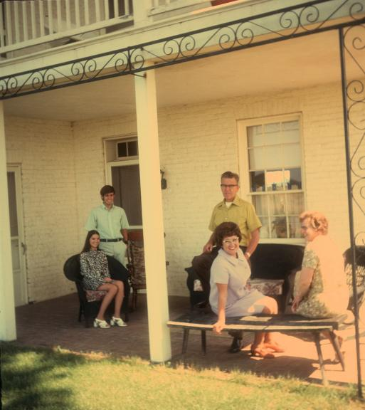
<number>
1970-LDB041 - On the front porch Paradise Manor - Hazel, Linda with Frank Subzda and Frank's parents

Slide 36
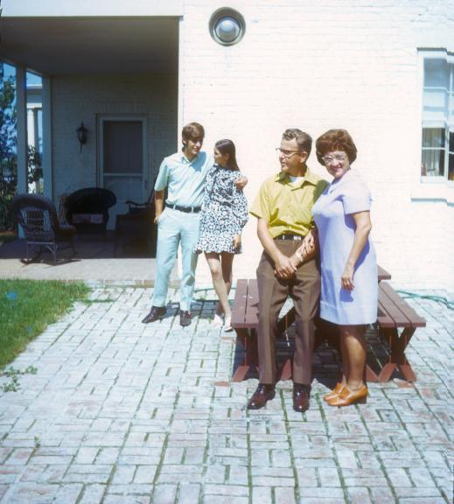
1970-LDB039 - BBQ on the terrace at Paradise Manor - Linda w Frank Subzda and Frank's parents
<number>

Slide 37
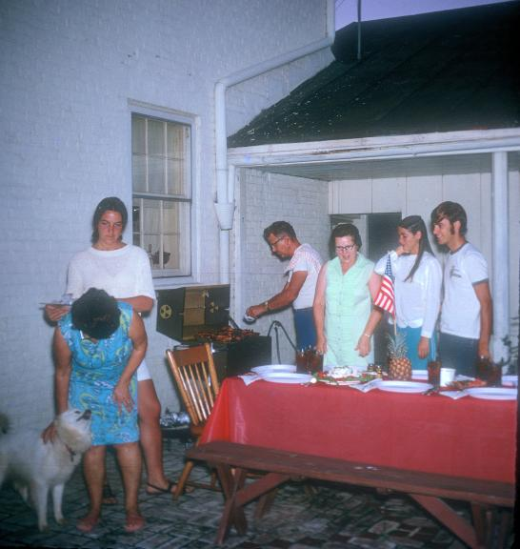
1970-LDB025 - BBQ on the terrace at Paradise Manor - Hazel, Linda wih Frank Subzda, his parents and Sage
<number>

Slide 38
LLF
Linda, Larry and Franklin
Each slide includes at least two of the above
<number>

Slide 39
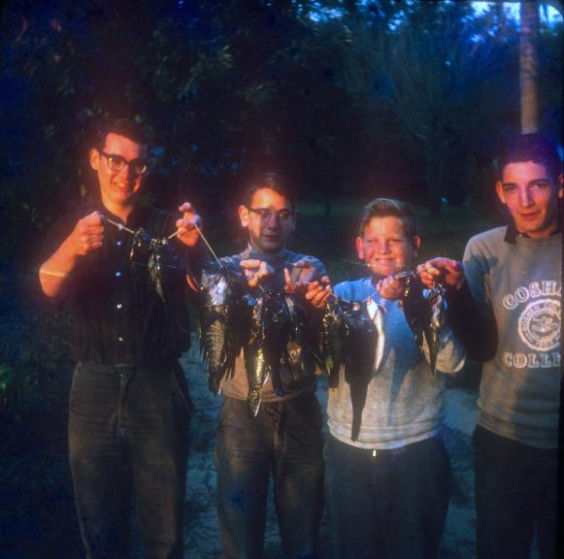
196_-LLF008 Larry Franklin Johnny Dennis fishing
<number>

Slide 40
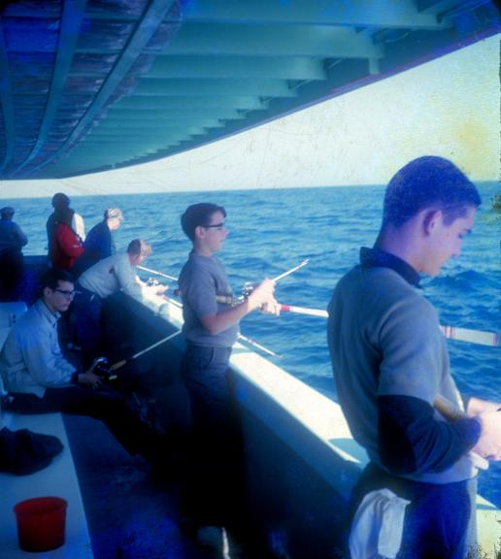
196_-LLF007 Franklin Larry Dennis and Johnny deep sea fishing Florida
<number>

Slide 41
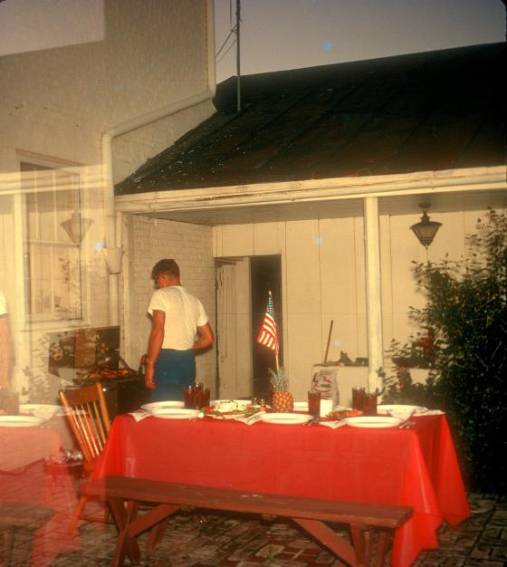
1970-LDB040- BBQ on the terrace at Paradise Manor - Frank Subzda's father
<number>

Slide 42
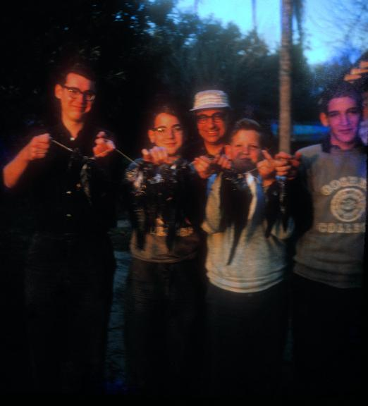
196_-LLF018 Larry Franklin Johnny Dennis fishing wirh Amos
<number>

Slide 43
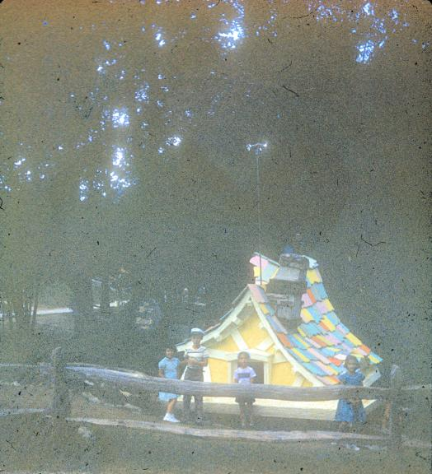
1955-LLF019 Linda, Larry and Franklin at the Enchanted Forest in 1955 (handwritten)
<number>

Slide 44
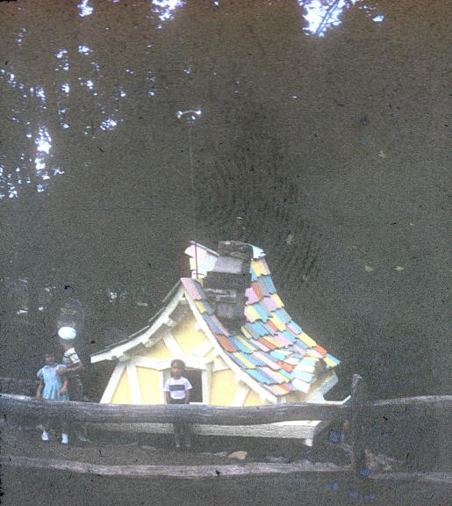
1955-LLF020 Linda, Larry and Franklin at the Enchanted Forest in 1955 (handwritten)
<number>

Slide 45
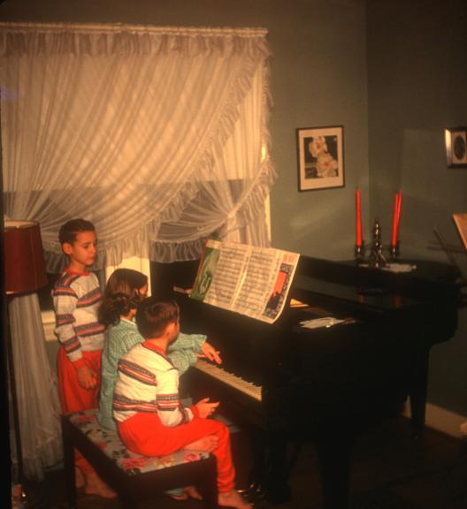
1955-LLF017 Linda, Larry and Frankie at the Maugansville piano - date estimated by the PJs
<number>

Slide 46
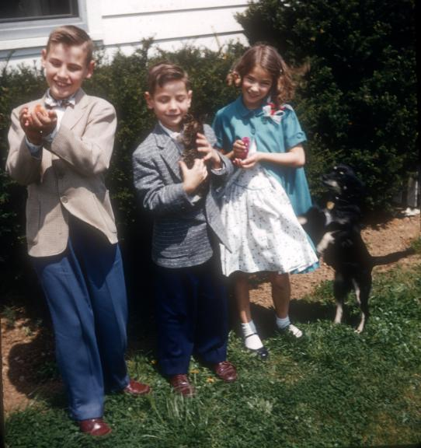
1955-LLF002 Linda Larry Franklin w Lassie and puppies
<number>

Slide 47
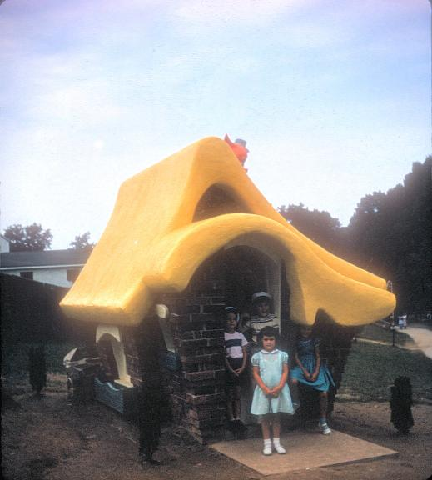
1955-LLF021 Linda, Larry and Franklin at the Enchanted Forest in 1955 (handwritten)
<number>

Slide 48
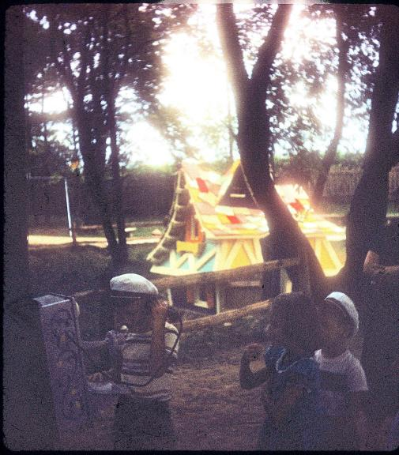
1955-LLF022 Linda, Larry and Franklin at the Enchanted Forest in 1955 (handwritten)
<number>

Slide 49
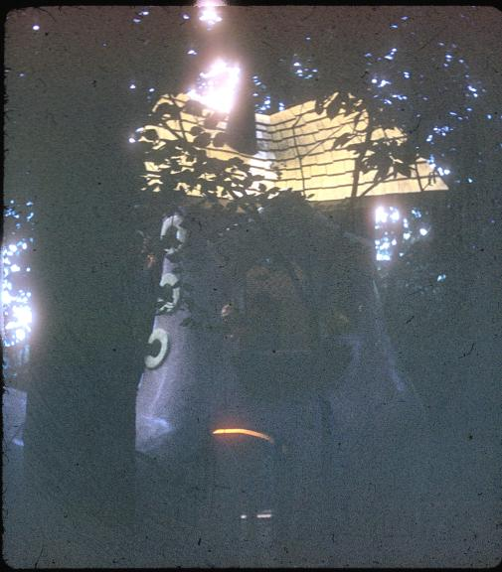
1955-LLF023 Linda, Larry and Franklin at the Enchanted Forest in 1955 (handwritten)
<number>

Slide 50
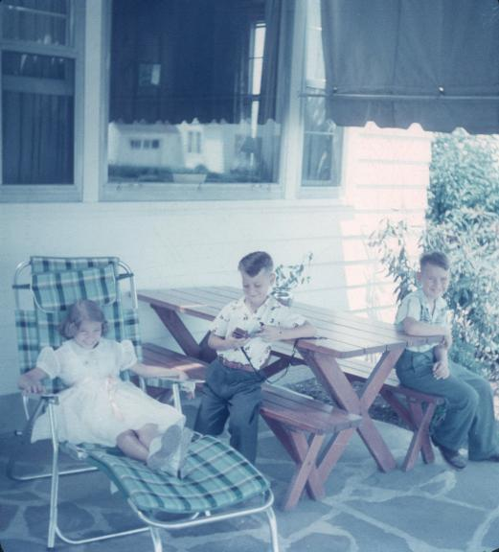
1956-LLF001 summertime
<number>

Slide 51
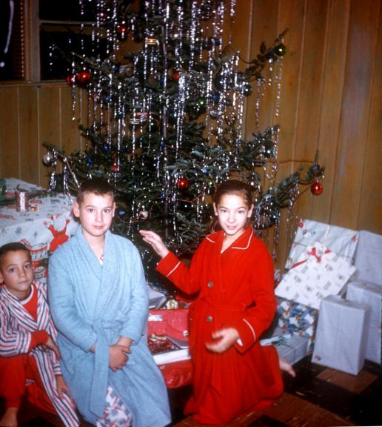
1958-LLF005 Christmas 1958 at Maugansville
<number>

Slide 52
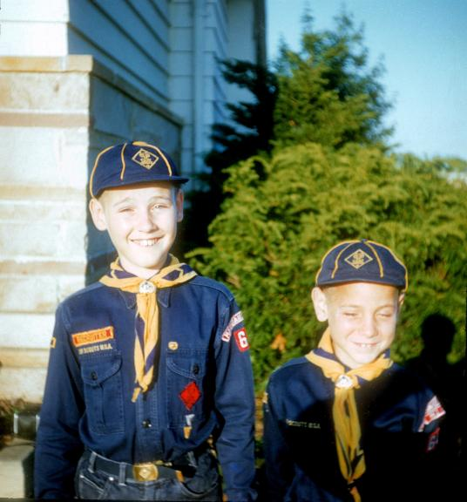
1958-LLF006 Larry and Franklin Cub Scouts 1958
<number>

Slide 53
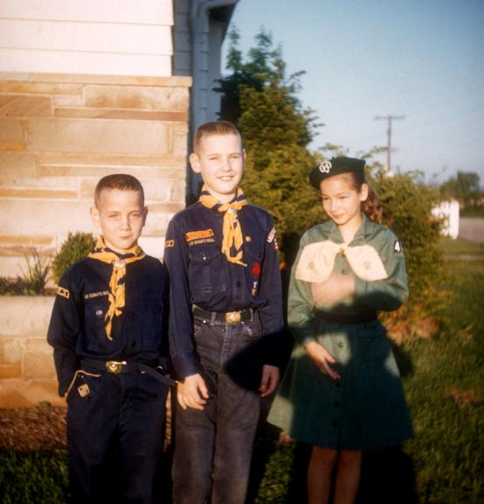
1958-LLF014 - Franklin, Linda and Larry in cub scout and brownie uniforms - 1958 slide date
<number>

Slide 54

1959-LLF004 Ready for 1st day of school Sept 1959
<number>

Slide 55

1959-LLF012 The Boys in Action - Frankie and Larry in the kitchen at Maugansville 1959 slide date
<number>

Slide 56

1960-LLF009 Linda Larry Franklin w Hazel Aunt Hannah & Bob Rumsby
<number>

Slide 57

1960-LLF013 An adorable trio - Franklin, Linda and Larry Baer - 1960
<number>

Slide 58

1960-LLF015 The Snow Fort Winter 1960 - Larry and friends 1960
<number>

Slide 59

1960-LLF016 The Snow Fort Winter 1960 - Larry and Franklin 1960
<number>

Slide 60

1962-LLF003 Portia Washington Pittman daughter of BTWashinton
<number>

Slide 61

1964-LLF010 Larry and Frank on the Maugansville couch (shot by Bill perhaps) at Christmas 1964
<number>

Slide 62

1964-LLF011 Bill Linda Larry Franklin playing cards at Maugansville living room
<number>

