Slide 1
TNN:
Nova Scotia, New Brunswick and New England

Slide 2
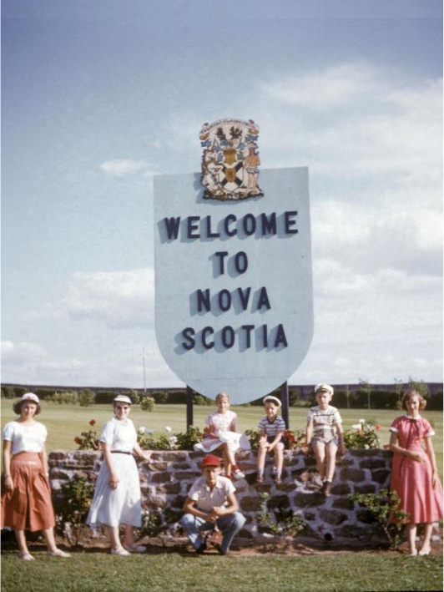
1955-TNN001 Hazel and family enering Nova Scotia 1955

Slide 3
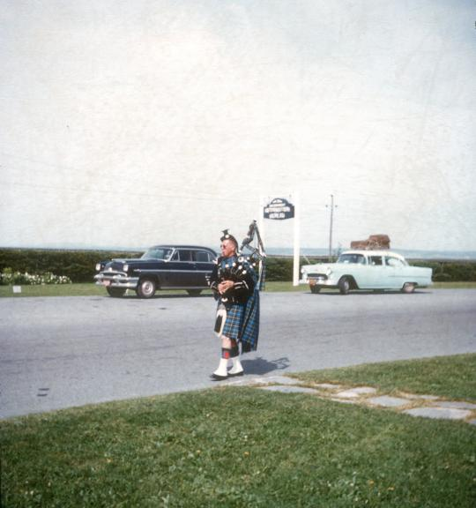
1955-TNN006 The Piper in Nova Scotia 1955

Slide 4
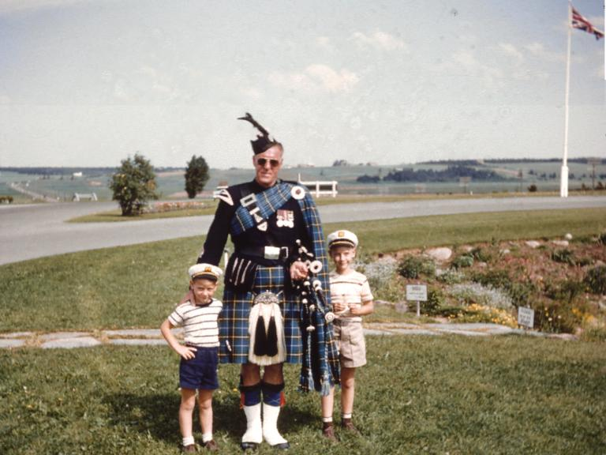
1955-TNN002 Entrance to Nova Scotia Canada Larry Franklin with true Scotsman

Slide 5
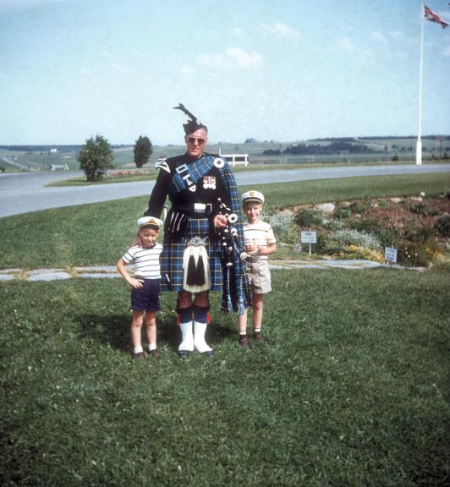
1955-TNN005 A true Scotsman with bagpopes Entrance to NScotia 1955

Slide 6
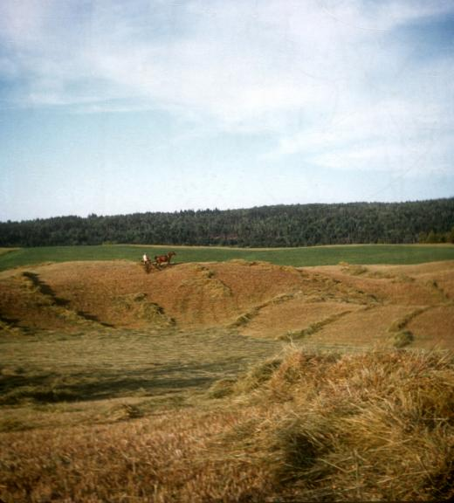
1955-TNN003 Haymaking in Nova Scotia 1955

Slide 7
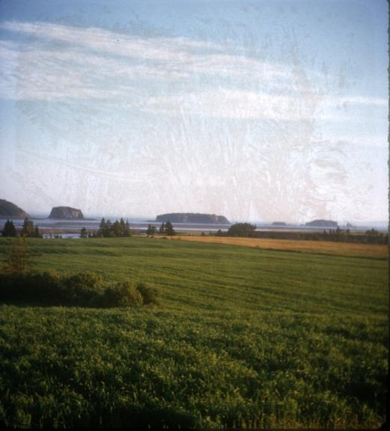
1955-TNN004 Five Islands Bay of Fundy Nova Scotia

Slide 8
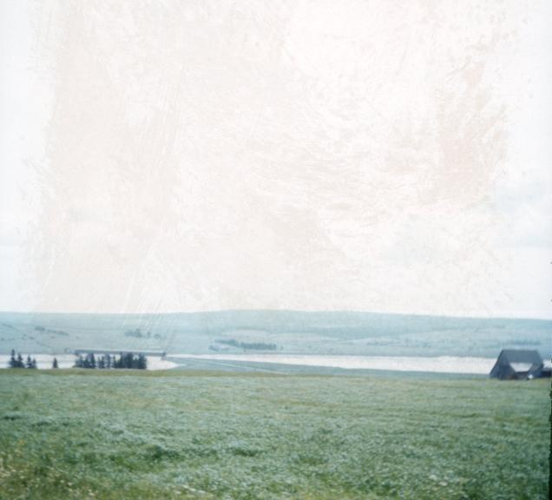
1955-TNN007 Covered bridge in New Brunswick 1955

Slide 9
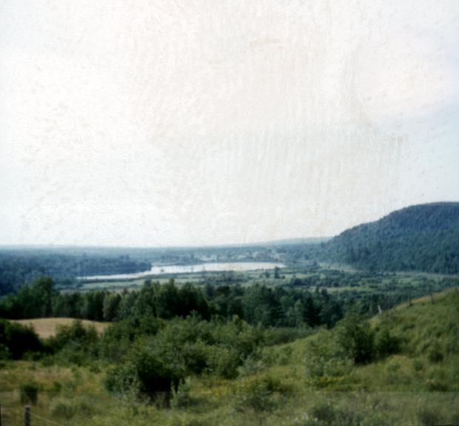
1955-TNN008 Grand Lake in New Brunswick 1955

Slide 10
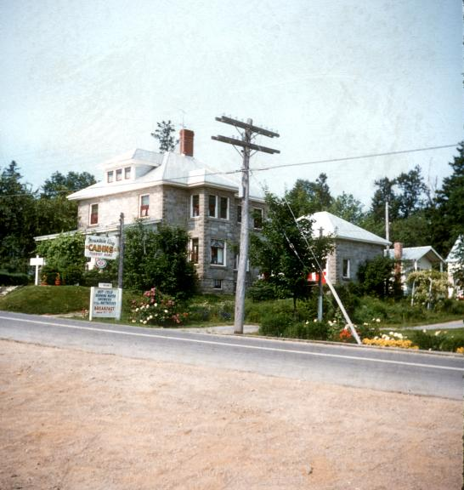
1955-TNN009 Russell Burrell residence at Harvey Station New Brunswick 1955

Slide 11
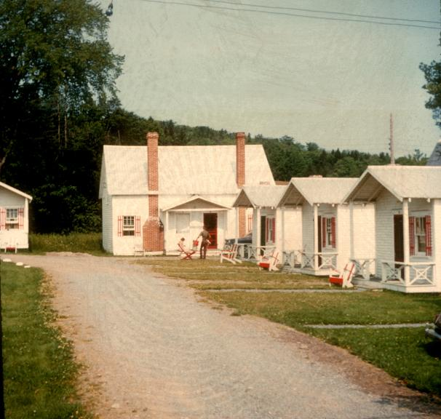
1955-TNN012 The Baers Cabin -large in back- Harvey Station New Brunswick 1955

Slide 12
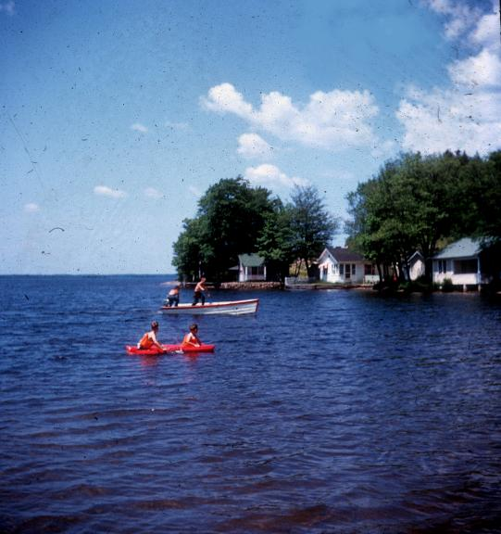
1955-TNN020 Away we go on a raft - Larry Frankie - Lake Harvey NB 1955

Slide 13
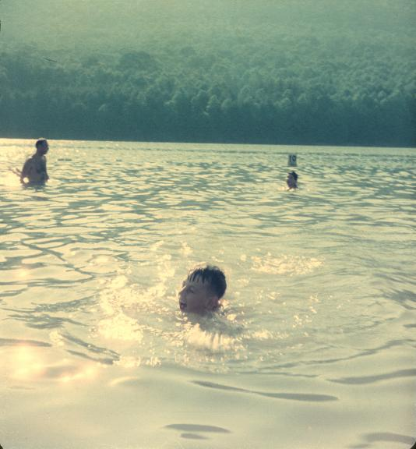
1955-TNN010 Larry in lake at Harvey Station New Brunswick 1955

Slide 14
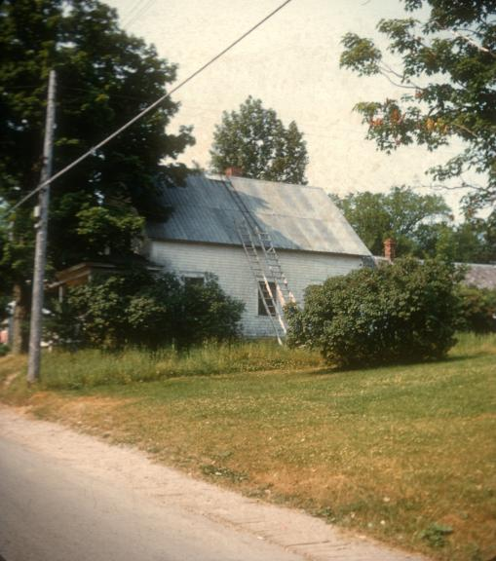
1955-TNN011 The Ladders New Brunswick 1955

Slide 15
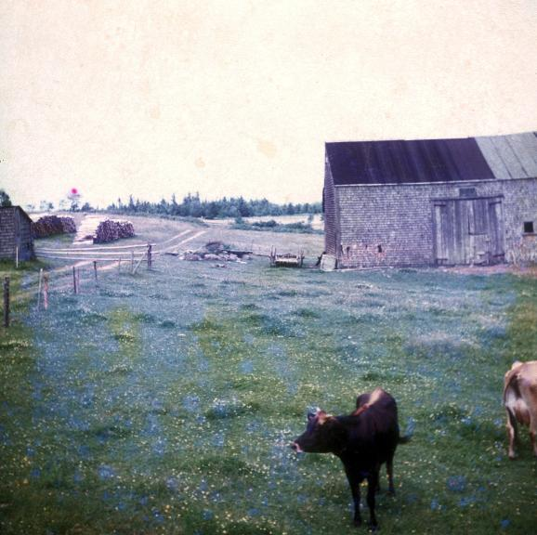
1955-TNN013 Farmland New Brunswick 1955

Slide 16
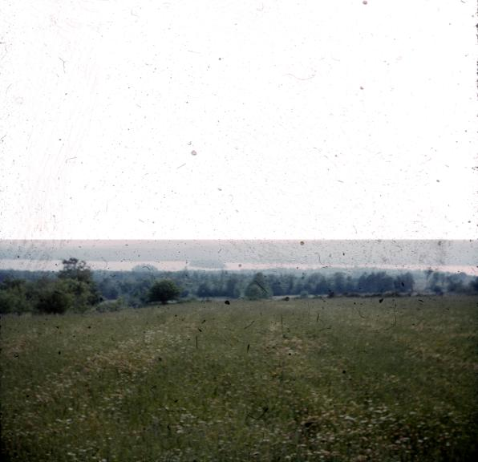
1955-TNN017 In the Distance - Wildwood Island NB 1955

Slide 17
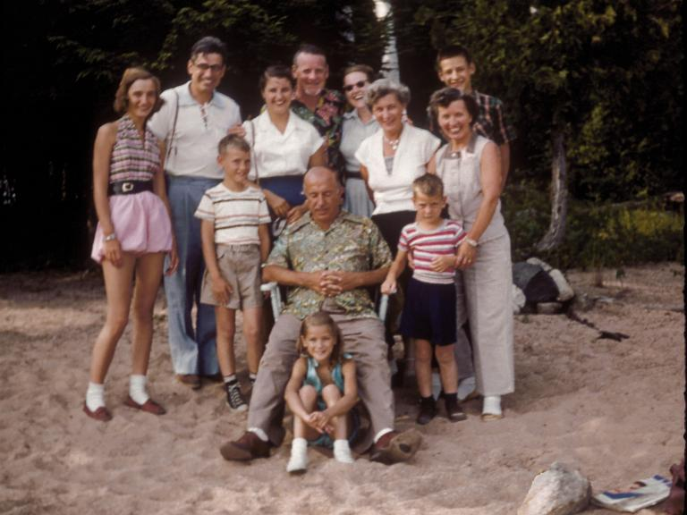
1955-TNN014 The Gang Wildwood Is NB Canada 1955

Slide 18
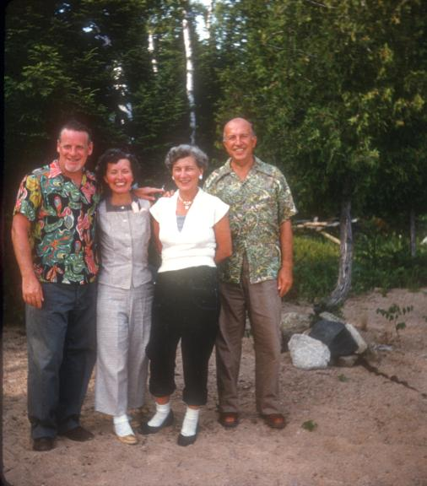
1955-TNN015 The Wildwood quartet Pat, Wanda Jean & Joe Wildwood Island NB 1955

Slide 19
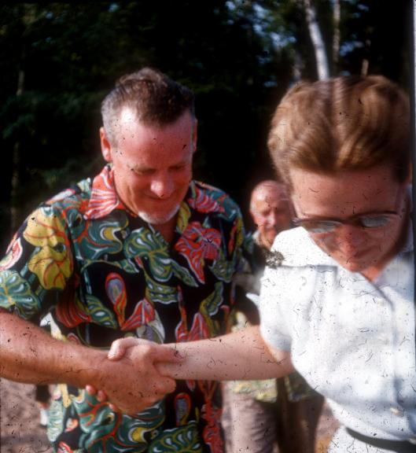
1955-TNN031 Hazel and Pat on Wildwood Island NB 1955

Slide 20
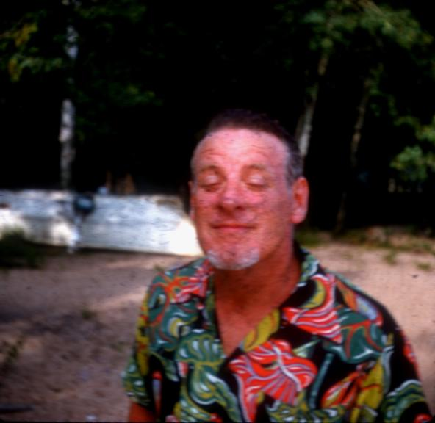
1955-TNN016 A week's growth Pat Kiernan Wildwood Island NB 1955

Slide 21
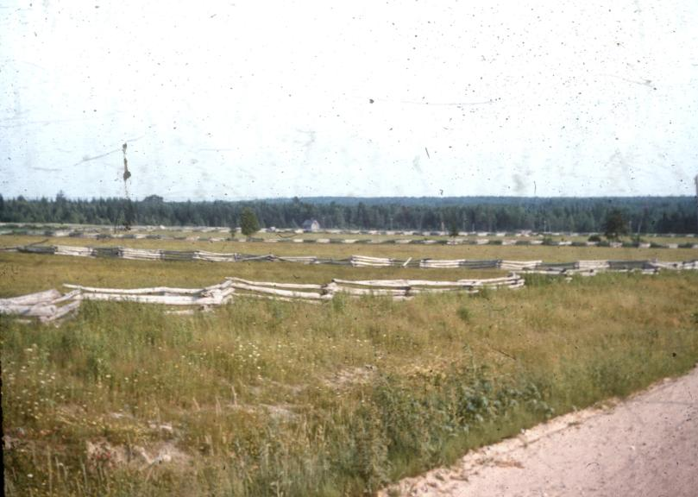
1955-TNN018 Fence Rows NB 1955

Slide 22
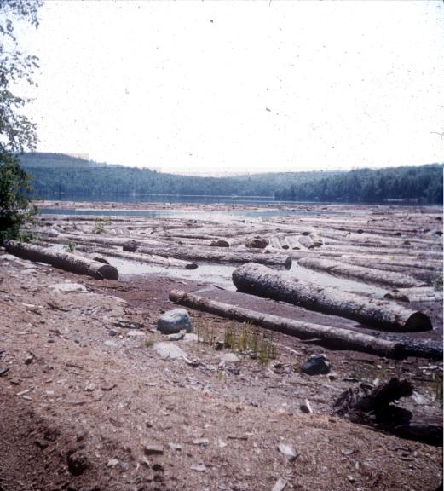
1955-TNN019 Log Float NB 1955

Slide 23
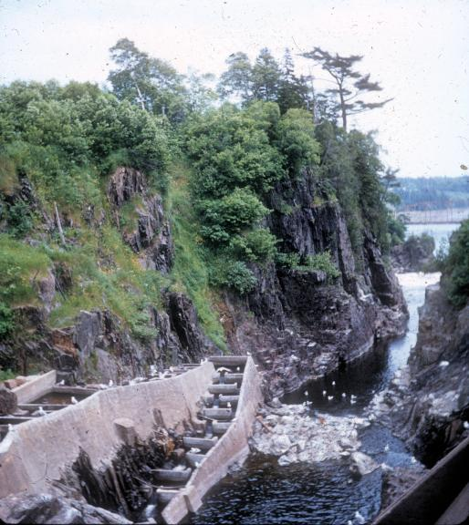
1955-TNN022 Salmon ladders at St. George New Brunswick 1955

Slide 24
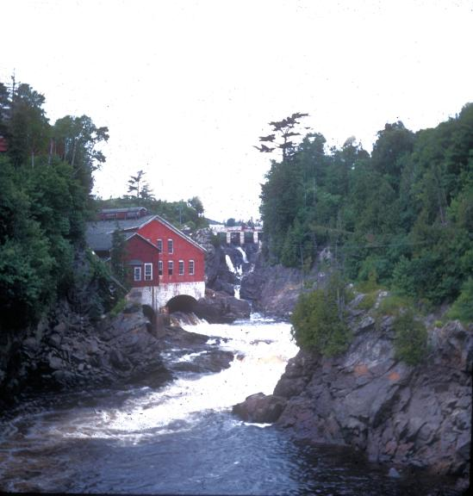
1955-TNN023 The gorge at St. George New Brunswick 1955

Slide 25
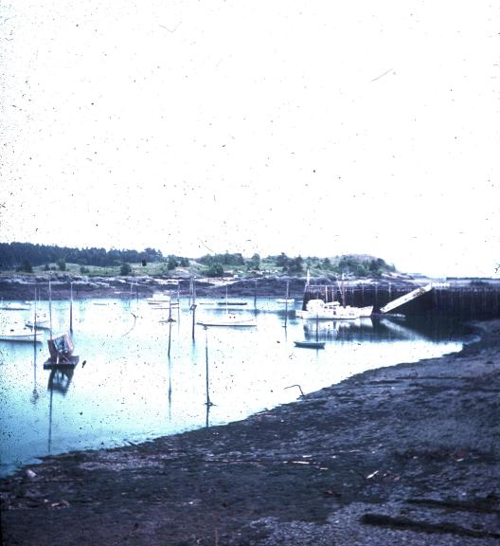
1955-TNN024 The waterfront on (dear) Deer Island Bay of Fundy New Brunswick 1955

Slide 26
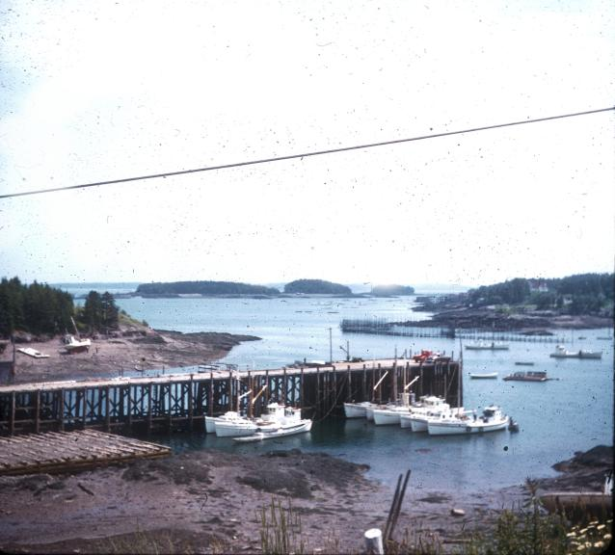
1955-TNN025 Sardine Fisheries Deer Island on Bay of Fundy NB 1955

Slide 27
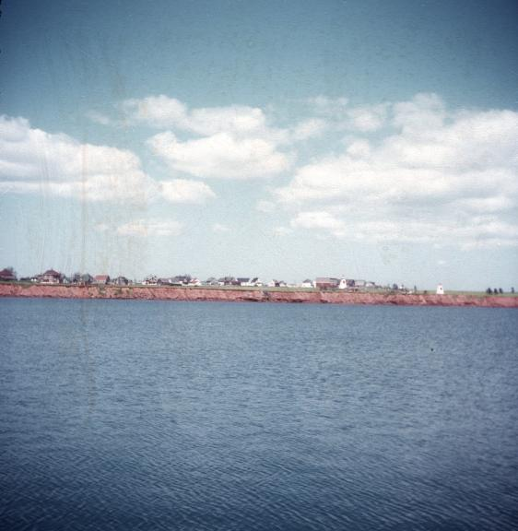
195_-TAP028 PRINCE EDWARD ISLAND - the red banks - no slide date

Slide 28
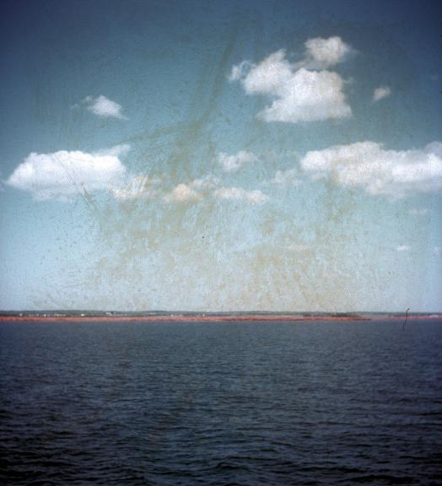
195_-TAP027 PRINCE EDWARD ISLAND - the red banks - no slide date

Slide 29
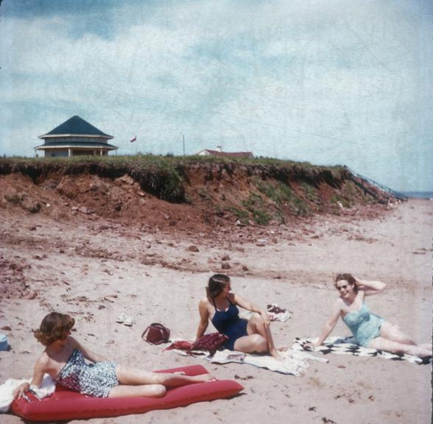
195_-TAP025 PRINCE EDWARD ISLAND - Our private beach - Hazel, Bonnie, Louise - no slide date

Slide 30
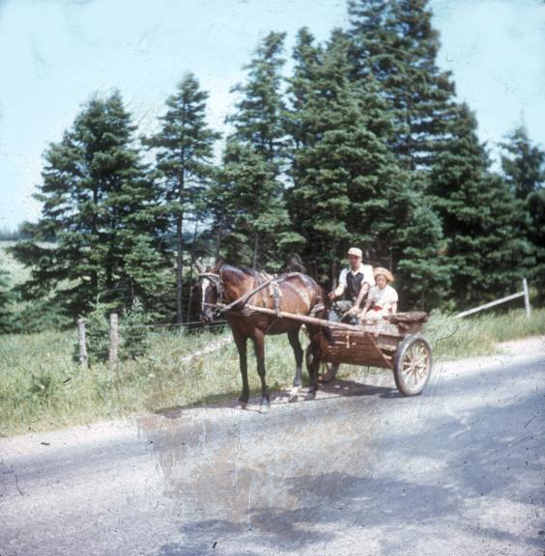
1955-TNN030 Natives of Prince Ed. Island in homemade crt - Dale Proude and daughter

Slide 31
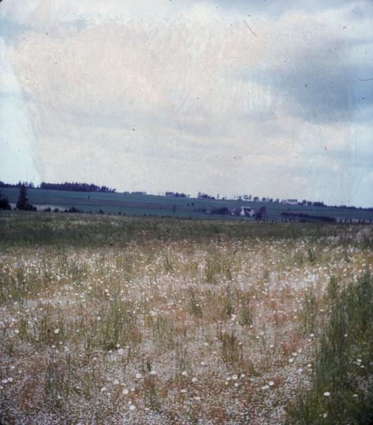
195_-TAP026 PRINCE EDWARD ISLAND - countryside - no slide date

Slide 32
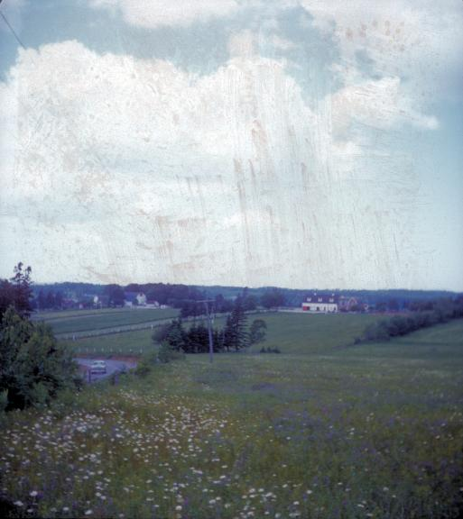
195_-TAP029 PRINCE EDWARD ISLAND - farmlands and houses - no slide date

Slide 33
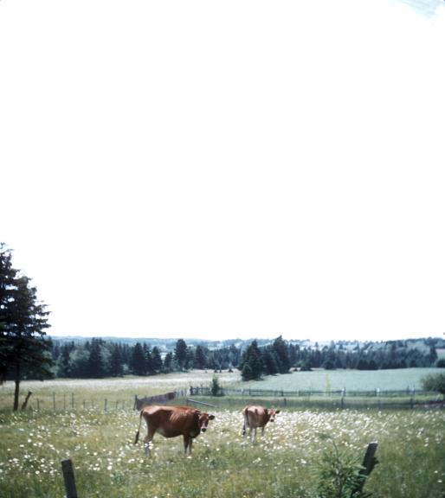
1955-TNN045 Country-Side Prince Edwards Island

Slide 34
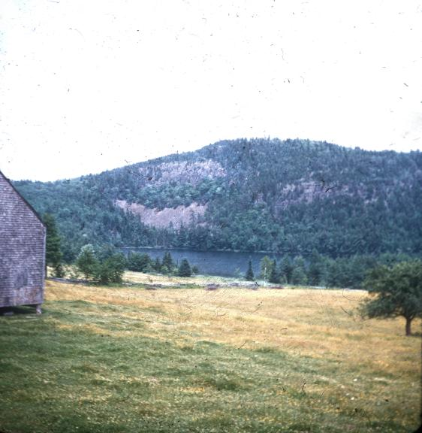
1955-TNN026 Lake and Mountain Seene NB 1955

Slide 35
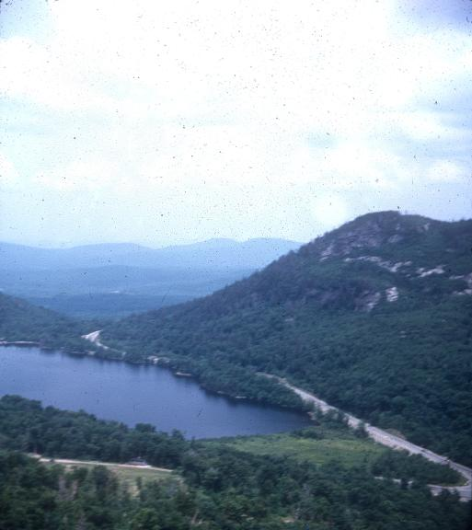
1955-TNN032 Franconia Notch New Hampshire 1955

Slide 36
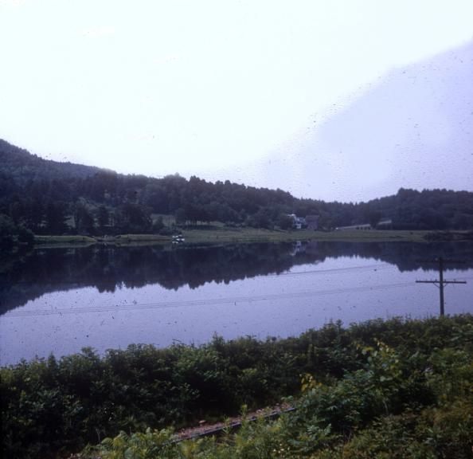
1955-TNN033 Relections in New Hampshire 1955

Slide 37
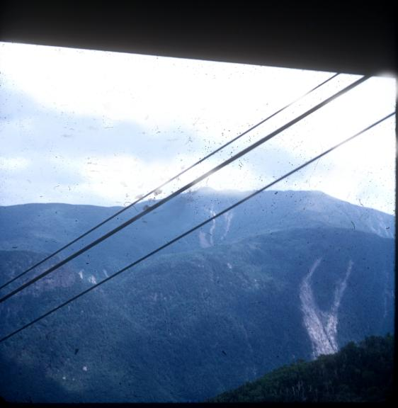
1955-TNN034 White Mts. New Hampshire taken from tramway 1955

Slide 38
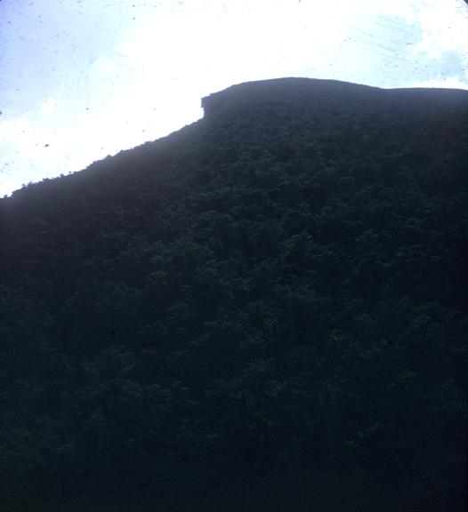
1955-TNN035 The Great Stone Face New Hampshire 1955

Slide 39
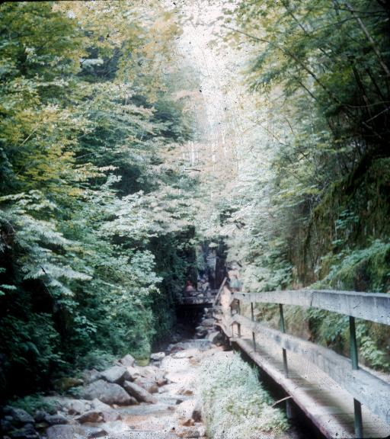
1955-TNN036 The Flume Gorge Franconia Notch New Hampshire Bills Red Cap 1955

Slide 40
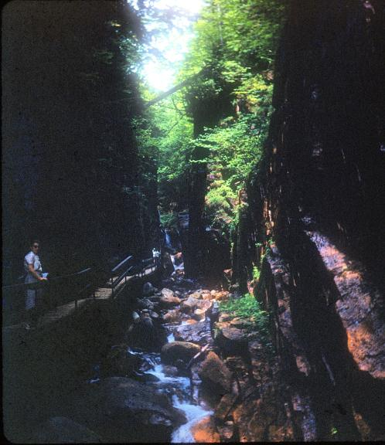
1955-TNN037 The Flume Gorge Franconia Notch New Hampshire w Mother 1955

Slide 41
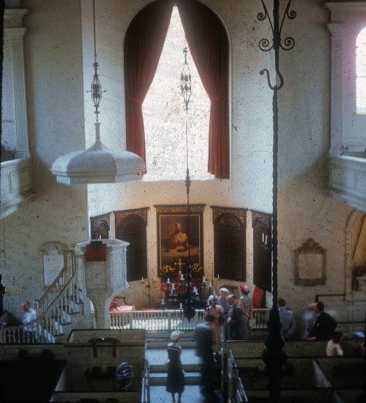
1955-TNN038 The chancel of the old North Church July 10 1955

Slide 42
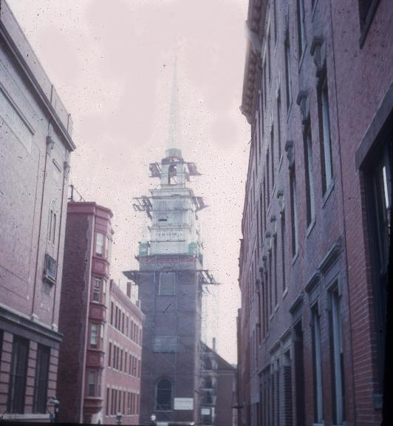
1955-TNN039 Spire of the old North Church (in scaffold) Boston, MA July 10 1955

Slide 43
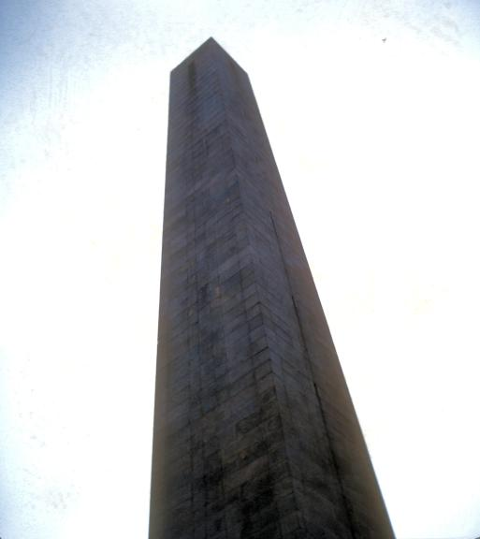
1955-TNN044 Bunker Hill Monument MA July 1955

Slide 44
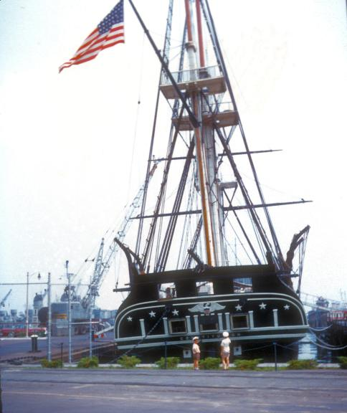
1955-TNN043 Old Ironsides with Larry and Frankie Boston Harbor, MA July 1955

Slide 45
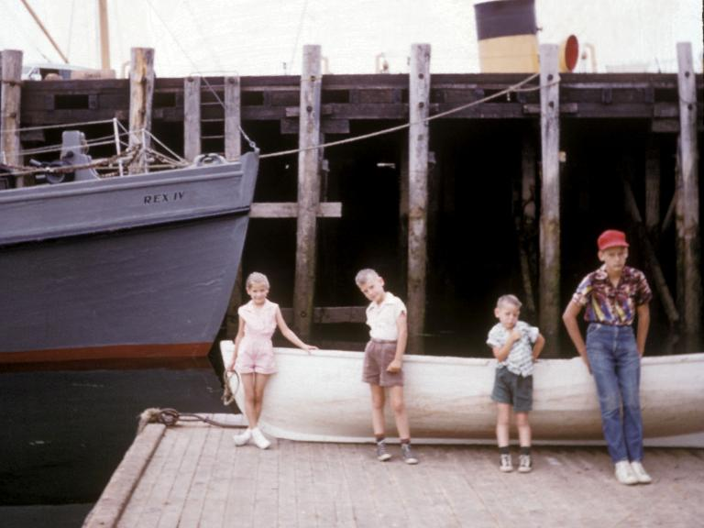
1955-TNN021 St Andrews Wharf NB, Canada 1955

Slide 46
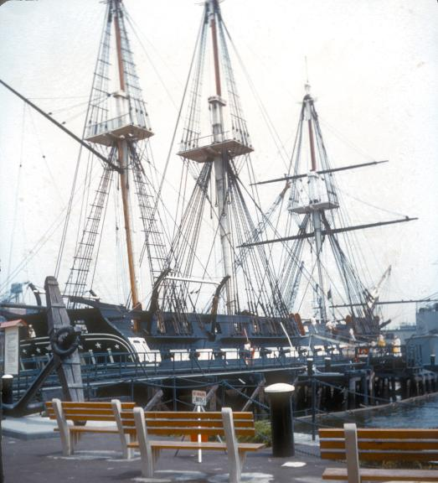
1955-TNN042 Old Ironsides Boston Harbor, MA July 1955

Slide 47
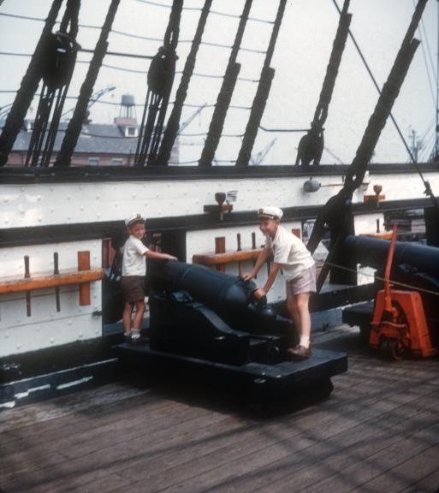
1955-TNN040 Man the Guns! Frankie 5yrs and Larry 7yrs on Old Ironsides Boston, MA July 1955

Slide 48
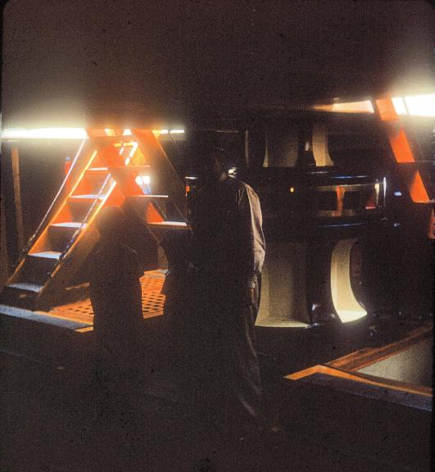
1955-TNN046 Down Under Old Ironsides Boston, MA July 1955

Slide 49
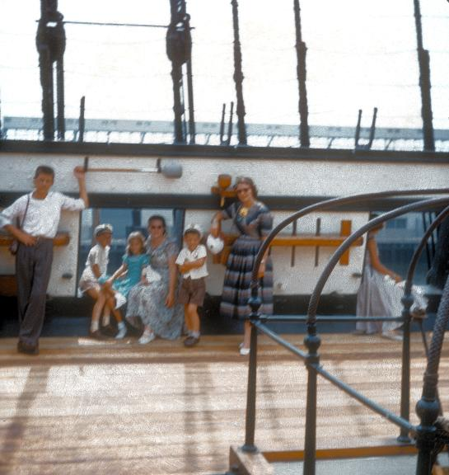
1955-TNN041 On Old Ironsides Boston, MA July 1955

Slide 50
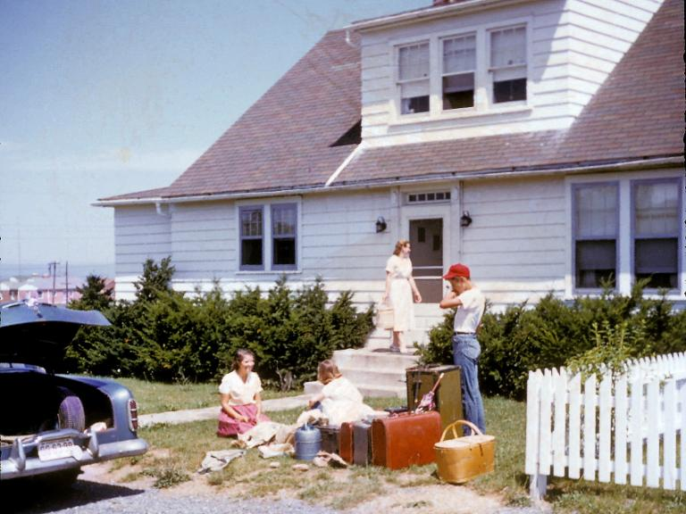
1955-TNN027 Home from Novia Scotia Canada

Slide 51
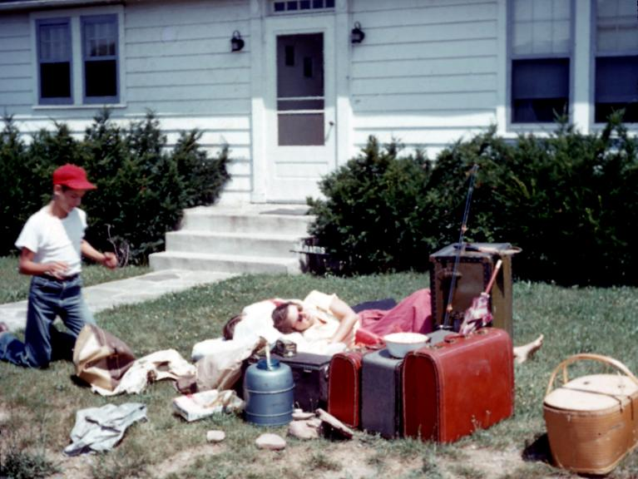
1955-TNN028 Bill Bonnie Home from Novia Scotia Jul 11 1955

Slide 52
Do the following slides belong to this trip?
If so, where do they belong?

Slide 53

1955-TNN047 Locks and More 1955

Slide 54

1955-TNN048 Locks and More 1955

Slide 55

1955-TNN049 Locks and More 1955

Slide 56

1955-TNN050 Locks and More 1955

Slide 57

1955-TNN051 Locks and More 1955

Slide 58

1955-TNN052 Locks and More 1955

Slide 59

1955-TNN053 Locks and More 1955

Slide 60

1955-TNN054 Locks and More 1955

Slide 61

1955-TNN055 Locks and More 1955

Slide 62

1955-TNN056 Locks and More 1955

Slide 63

1955-TNN057 Locks and More 1955

