Slide 1
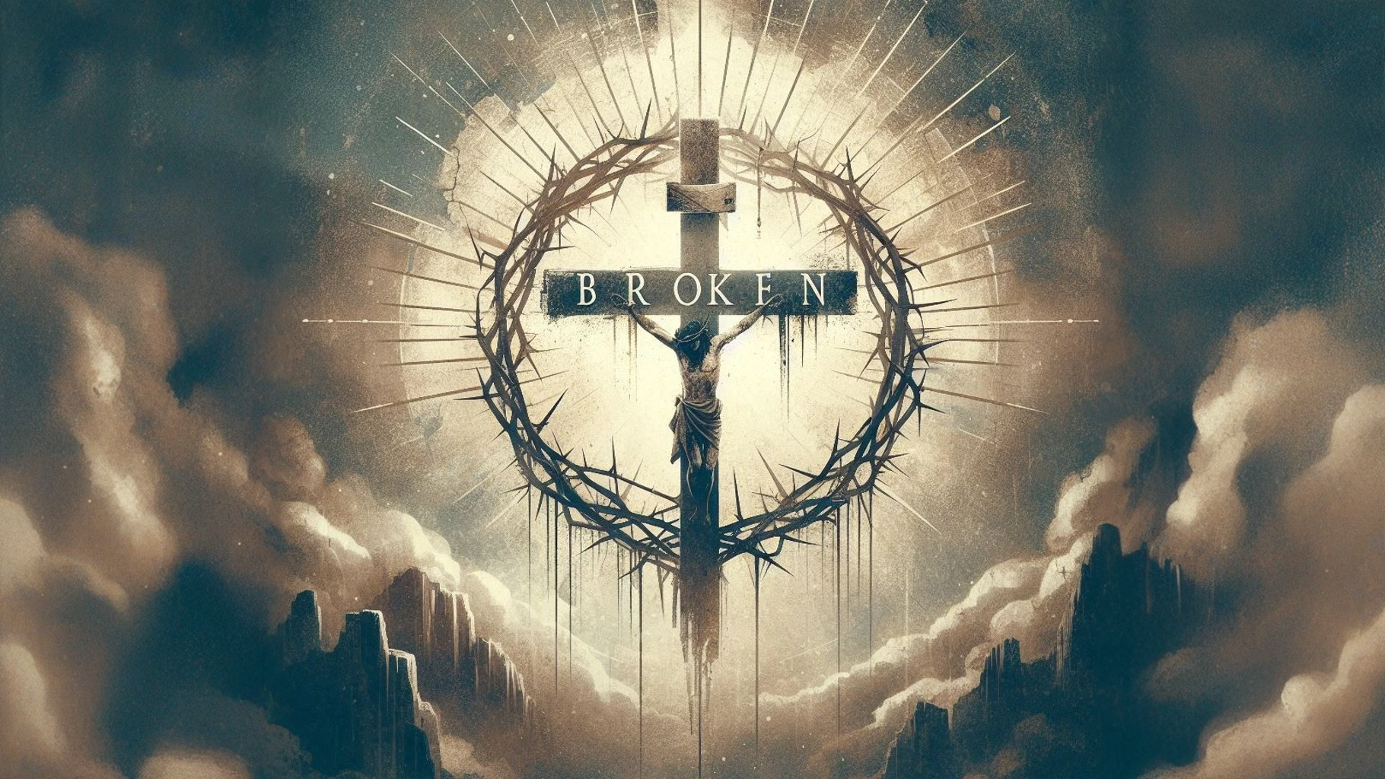
Isaiah 57:15

Slide 2
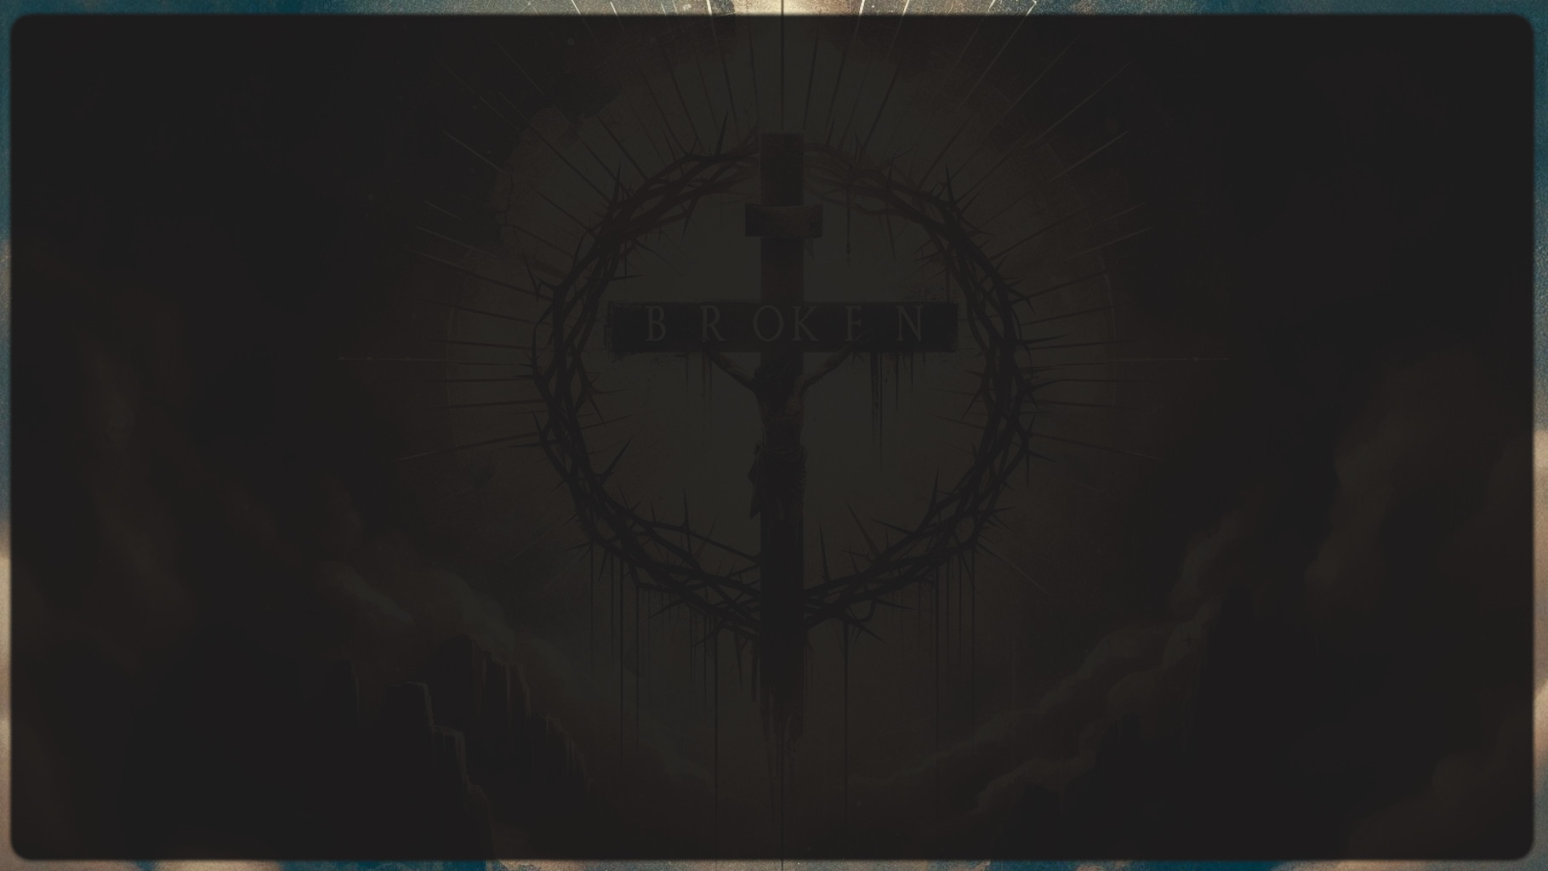
Isaiah 57:15
For the High and Exalted One, who lives forever, whose name is holy, says this: “I live in a high and holy place, and with the oppressed and lowly of spirit, to revive the spirit of the lowly and revive the heart of the oppressed.

Slide 3
Selfish-pride - aligns us with an earthly mission that is me focused and it adopts the strategies of Satan to accomplish the mission - manipulation, intimidation, and domination.

Slide 4
Selfish-pride - aligns us with an earthly mission that is me focused and it adopts the strategies of Satan to accomplish the mission - manipulation, intimidation, and domination.
Brokenness aligns us with a heavenly mission that is Christ focused and it adopts the strategies of Jesus to accomplish the mission - Speaking the Truth, gentleness or peacemaking, and sacrifice.

Slide 5
Nothing to Protect and Nothing to Lose

Slide 6
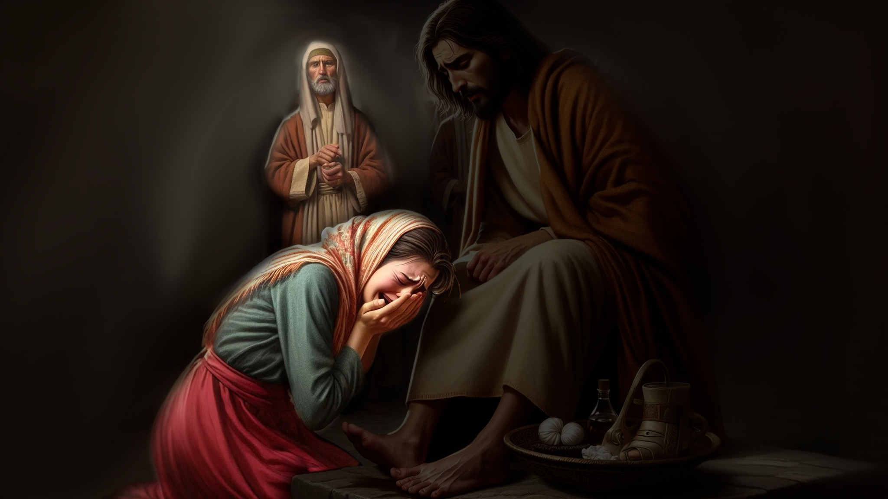

Slide 7
Nothing to Protect and Nothing to Lose

Slide 8
Proud people focus on the failures of others and can readily point out those faults.
Broken People are more conscious of their own spiritual need than of anyone else’s.
Proud people are especially prone to criticize those in positions of authority-their pastor, their boss, their husband, their parents-and they talk to others about the faults they see.
Broken people reverence, encourage, and lift up those that God has placed in positions of authority, and they talk to God in intercession, rather than gossiping about the faults they see in others.

Slide 9
Proud people have an independent, self-sufficient spirit.
Broken people have a dependent spirit; they recognize their need for God and for others.
Proud people are self-protective of their time, their rights, and their reputation.
Broken people are self-denying and self-sacrificing.
Proud people desire to be known as a success.
Broken people are motivated to be faithful and to make others successful.

Slide 10
Proud people crave self-advancement.
Broken people desire to promote others.
Proud people get wounded when others are promoted, and they are overlooked.
Broken people are eager for others to get the credit, and they rejoice when others are lifted up.
Proud People are self-conscious; they worry about what others think of them.
Broken people are not preoccupied with what others think of them.

Slide 11
Proud people are concerned about appearing respectable; they are driven to protect their image and reputation.
Broken people are concerned with being real; they care less about what others think than about what God knows-they are willing to die to their own reputation.
Proud people can't bear to fail or for anyone to think they are less than perfect. This can drive them to extremes-workaholic tendencies, perfectionism, the tendency to drive others or to place unrealistic expectations on themselves or others.
Broken people can recognize and live within God-given limitations.

Slide 12
Proud people wait for others to come and ask forgiveness when there is a misunderstanding or a breach in a relationship.
Broken people take the initiative to be reconciled, no matter how wrong the other party may have been.
Proud people find it difficult to discuss their spiritual needs with others.
Broken people are willing to be open and transparent with others as God directs.
Proud people become bitter and resentful when they are wronged; they have emotional temper tantrums; they hold others hostage and are easily offended; they carry grudges and keep a record of others' wrongs.
Broken people give thanks in all things; they are quick to forgive those who wrong them.

Slide 13
Proud people want to be sure that no one finds out when they have sinned; their instinct is to cover up and they confess with vague generalities.
Broken people aren't overly concerned with who knows or who finds out about their sin-they are willing to be exposed because they have nothing to lose, and they are able to acknowledge specifics when confessing their sin.
Proud people don't think they need revival, but they are sure everyone else does. (in fact, right about now, they are making a mental list of the people they think need to read this list!)
Broken people continually sense their need for a fresh encounter with God and for a fresh filling of his holy spirit.

Slide 14
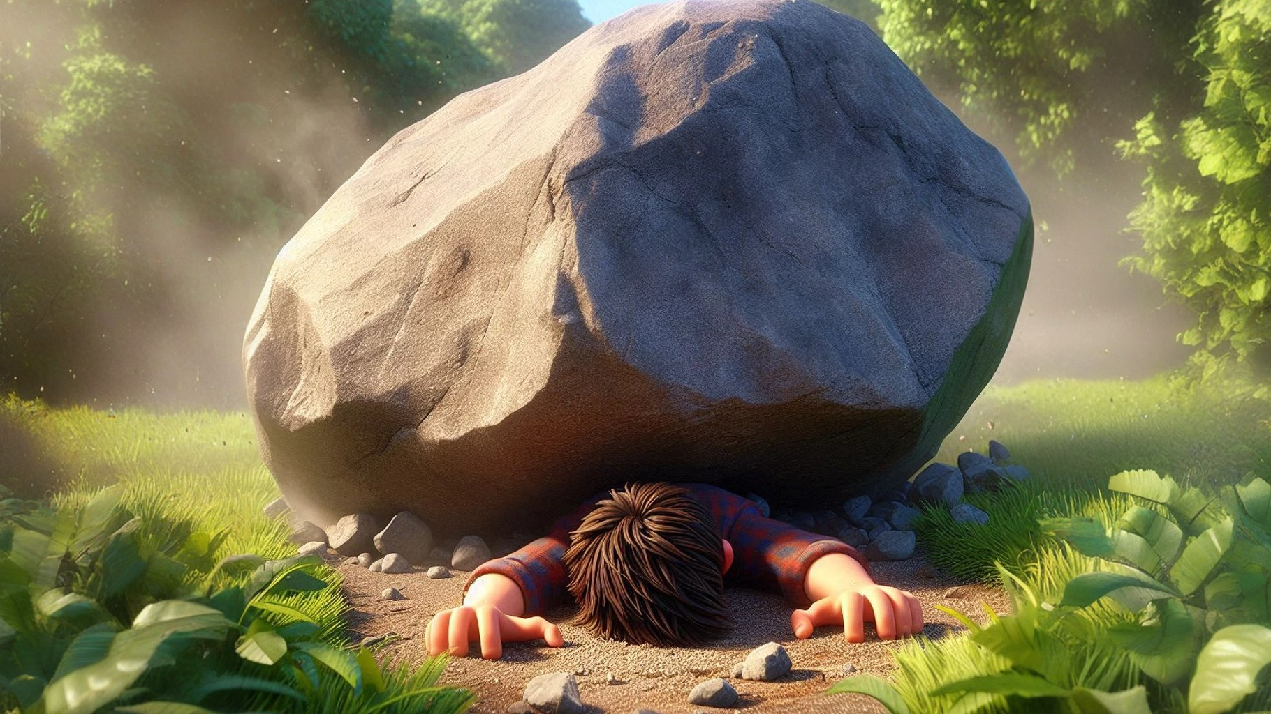

Matthew 21:44 Whoever falls on this stone will be broken to pieces; but on whomever it falls, it will shatter him.”

Slide 15
Isaiah 57:15
“I live in a high and holy place, and with the oppressed and lowly of spirit, to revive the spirit of the lowly and revive the heart of the oppressed.

